Slide 1
Module 8: Create Dashboards

Slide 2
Learning Objectives
You will learn the following concepts:
Dashboards
Real-time Dashboards
Enhancing Dashboards
Notes:
By the end of this module, you’ll be able to:
Create and use Dashboards and understand their purpose.
Create Real-time dashboards
Enhancing existing dashboards

Slide 3
Lesson 1: Create a Dashboard

Slide 4
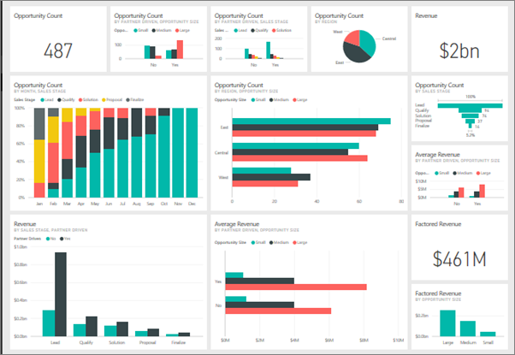
Introduction to Dashboards
A dashboard:
Is a single-page canvas that tells a story through visualizations.
Can draw from multiple reports.
Contains no Filter, Visualization, or Fields pane.
Does not display the underlying dataset.
Notes:
A Power BI dashboard is a single page, often called a canvas, that tells a story through visualizations. Because it's limited to one page, Well-built dashboards capture the main, most important highlights of the story that you are trying to tell. Readers can view related reports for the details.
Microsoft Power BI dashboards are different than Power BI reports. Dashboards allow report consumers to create a single artifact of directed data that is personalized just for them. Dashboards can be comprised of pinned visuals that are taken from different reports. Where a Power BI report uses data from a single dataset, a Power BI dashboard can contain visuals from different datasets.
When would you want to build a dashboard versus a report? The following list explains the key similarities and differences worth noting when you are determining the right path for you:
Dashboards can be created from multiple datasets or reports.
Dashboards do not have the Filter, Visualization, and Fields panes that are in Power BI Desktop, meaning that you can't add new filters and slicers, and you can't make edits.
Dashboards can only be a single page, whereas reports can be multiple pages.
You can't see the underlying dataset directly in a dashboard, while you can see the dataset in a report under the Data tab in Power BI Desktop.
Both dashboards and reports can be refreshed to show the latest data.
Tiles are the individual report elements, or snapshots, of your data that are then pinned to a dashboard. You can pin an entire report page, or you can pin individual tiles.
Report: The pinning process pulls visuals from your report and "pins" them to a dashboard for easy viewing. When you make changes to any of the visuals in the report, changes will be reflected on the dashboard.
Visual: You can pin a visual from a different report (and different dataset) to an existing dashboard. When pinning a report element to a dashboard, you create a direct connection between the dashboard and the report that the snapshot came from.

Slide 5
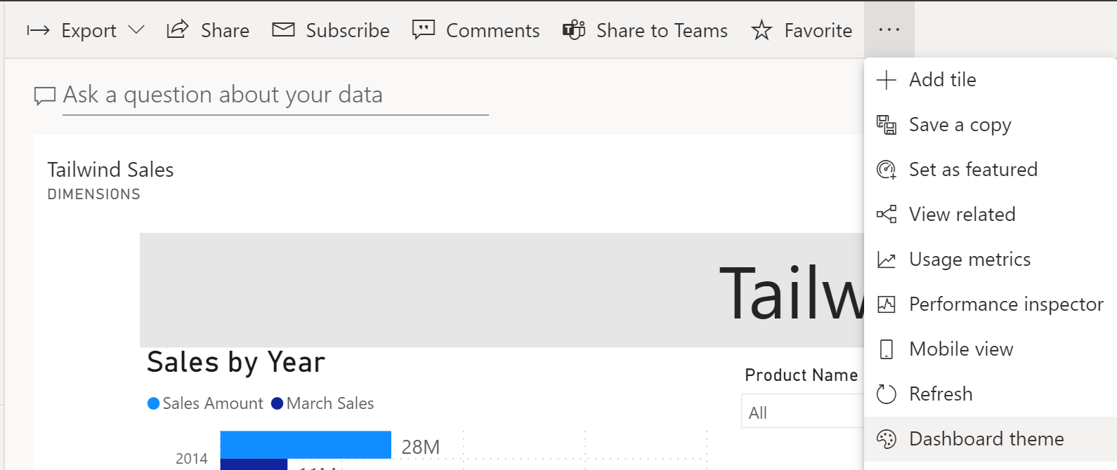
Add a Dashboard Theme
Create a cohesive picture across dashboards using themes.
Notes:
When building dashboards, you should consider ensuring that the same theme is applied to your dashboards to create a cohesive picture. You could also apply a specific theme to reports and dashboards so that all report elements or tiles are uniform. This consideration is particularly important when you are building multiple dashboards. Power BI has the functionality to apply a theme directly to all visuals of a report.
Themes in Power BI
A variety of themes are available for use in Power BI service. Go to a dashboard, select the ellipsis (...), and then select Dashboard theme.

Slide 6
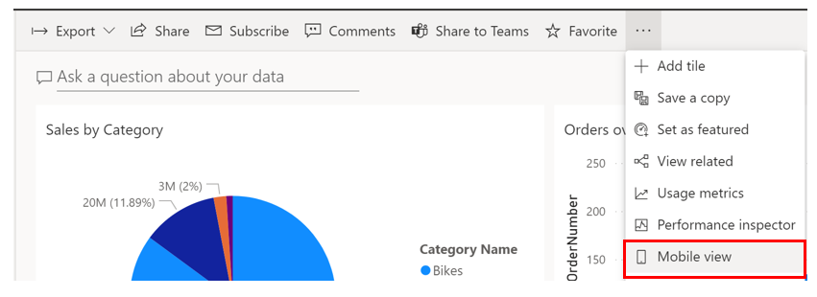
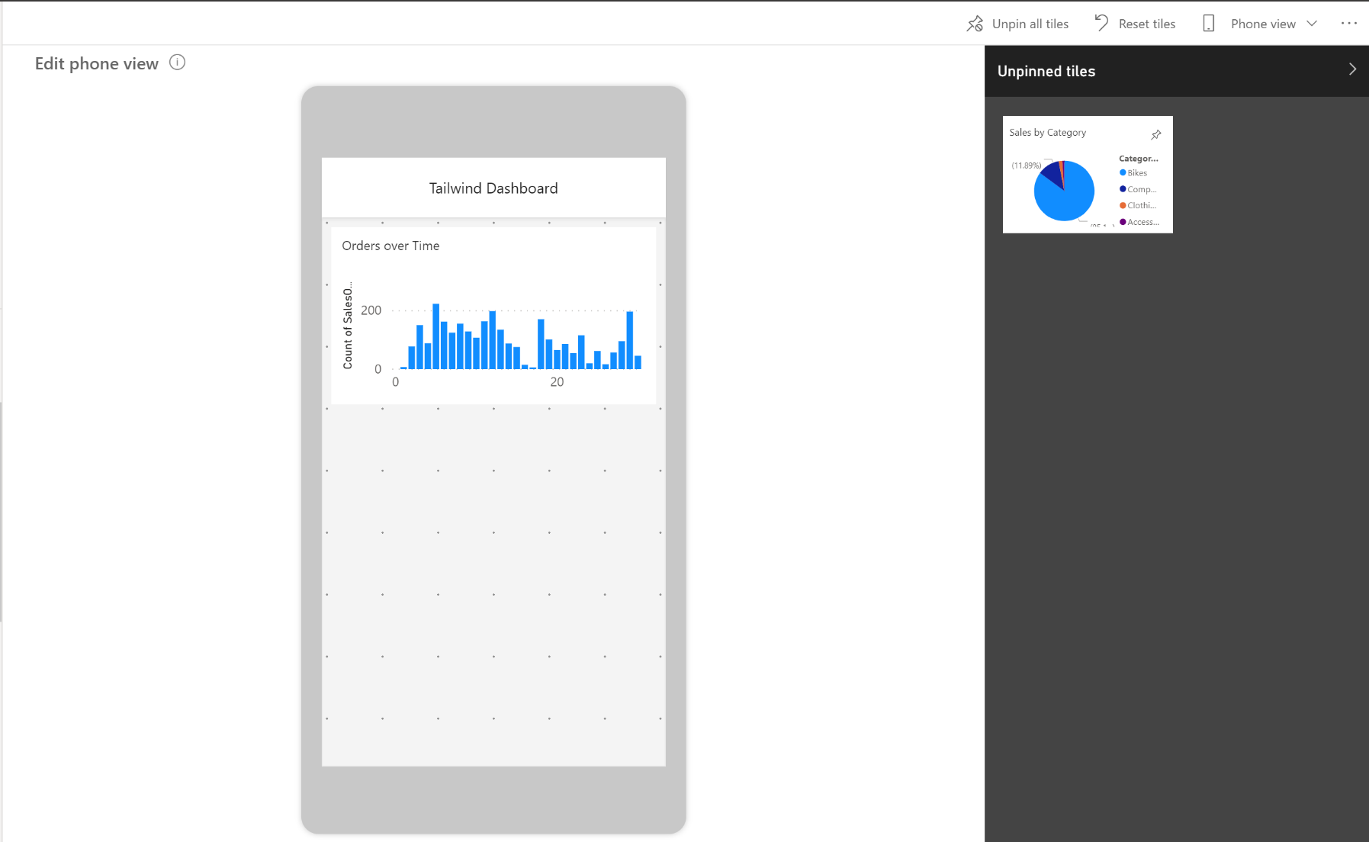
Set Mobile View
Let your users stay connected wherever they are.
Notes:
Power BI reports are built in Power BI Desktop and then deployed to Power BI service, where they can be viewed and shared. However, if you are building dashboards for the Sales team at your organization and you receive a requirement that the dashboards should also be viewable on mobile devices, Power BI will help you to set dashboards to mobile view.
In the mobile view in Power BI Desktop, you are able to accomplish several tasks. This view emulates the view of a user who is looking at visuals on their phone, so you can add visuals to this view, resize them, and change the formatting on them, as shown in the ensuing screenshot. In the June 2020 release of Power BI Desktop, a new grid has been added to this view so that you can position your visuals with more ease and overlay visuals on top of each other. This feature can be useful if you want to insert a visual on top of an image.
When you view dashboards in portrait mode on a phone, you notice the dashboard tiles are laid out one after another, all the same size. In the Power BI service, you can create a customized view of a dashboard, specifically for portrait mode on phones. Even if you create a phone view, when you turn the phone sideways, you see the dashboard as it's laid out in the service.
LIVE means: As you edit the phone view, anyone viewing the dashboard on a phone can see the changes you make in real time. For example, if you unpin all tiles on the dashboard phone view, the dashboard on the phone will suddenly have no tiles.
You can also optimize your dashboards for mobile view in Power BI service.
Benefits:
Resize and reposition the tiles and visuals in whichever order you want.
This phone view is customizable for each person who uses the dashboard; selecting Phone view will allow you to create a new view that you can see on your phone when signing in to Power BI service.
A new grid has been added to this view so that you can position your visuals with more ease and overlay visuals on top of each other. This feature can be useful if you want to insert a visual on top of an image.
You can add visuals to this view, resize them, and change the formatting on them,

Slide 7
Lesson 2: Real-time Dashboards

Slide 8
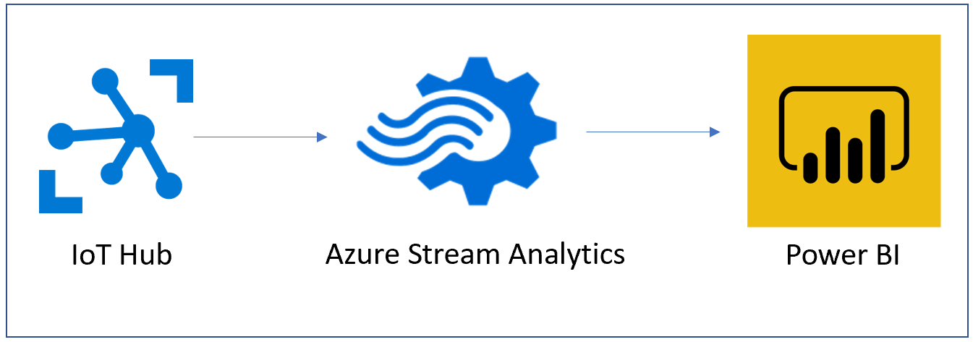
Create a Real-time Dashboards
Stream data and update dashboards as soon as the data is logged.
Notes:
In this data-centric world, it has become increasingly important to have the ability to view how data changes in real time. This ability is particularly important in the context of dashboards; these are the canvases on which you can tell the story of the data, so the ability to show real-time, streaming data on these dashboards can be important to your business. With Power BI's real-time streaming capabilities, you can stream data and update dashboards as soon as the data is logged.
Streaming data can come from a variety of sources, including from social media, factory sensors, service-usage metrics, and other sources that contain a constant stream of data points. A common scenario are sensors that send a stream of telemetry data to IoT hub. From the IoT hub, you can use a stream insight job to aggregate the data, then you can retrieve the data into Power BI as a streaming dataset, where you can consume the information and build the pertinent visuals.
Data that comes from a streaming dataset is not stored in a Power BI data model; instead, it is stored in a temporary cache. Consequently, you cannot model the data with this type of dataset. The only way to visualize the data from a streaming data source is to create a tile directly on a dashboard and use a custom streaming data source.
After you have selected the new dataset, select Next, enter the details for your streaming dataset, and then add a new streaming dataset tile. Streaming dataset tiles can be in the form of line charts, stacked bar charts, cards, and gauges and are formatted similarly to any other kind of tile.

Slide 9
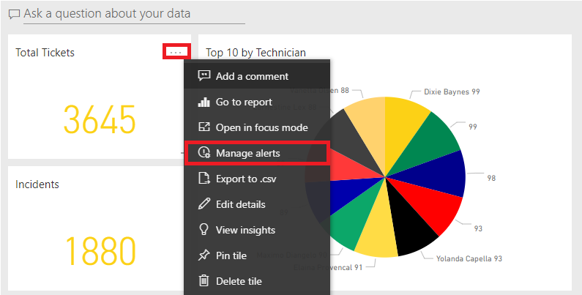
Configure Data Alerts
Notify users that a specific data point has reached a defined threshold.
Notes:
Configuring data alerts is a simple process to complete on a dashboard in Power BI. Data alerts can be used to notify you or a user that a specific data point is above, below, or at a specific threshold that you can set. These alerts are features that are only available on Power BI service and they are available on such report elements as KPI visuals, gauges, and cards.
You can set alerts on tiles in your My Workspace. You can also set alerts if someone shares a dashboard that's in a Premium capacity. If you have a Power BI Pro license, you can set alerts on tiles in any other workspace, too. Alerts can only be set on tiles pinned from report visuals, and only on gauges, KPIs, and cards.
Data alerts are fully synchronized across platforms; set and view data alerts in the mobile app and in the Power BI service. They aren't available for Power BI Desktop. You can even automate and integrate alerts with Power Automate.
To create:
Select the ellipsis (...) in the corner of the tile on the dashboard and then select Manage Alerts.
In the resulting window, select + Add Alert Rule
You can choose the threshold that you want to create the alert for, which includes options for Above or Below a specific threshold.
Ensure that the Active toggle switch is turned On

Slide 10
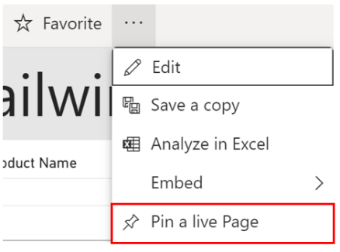
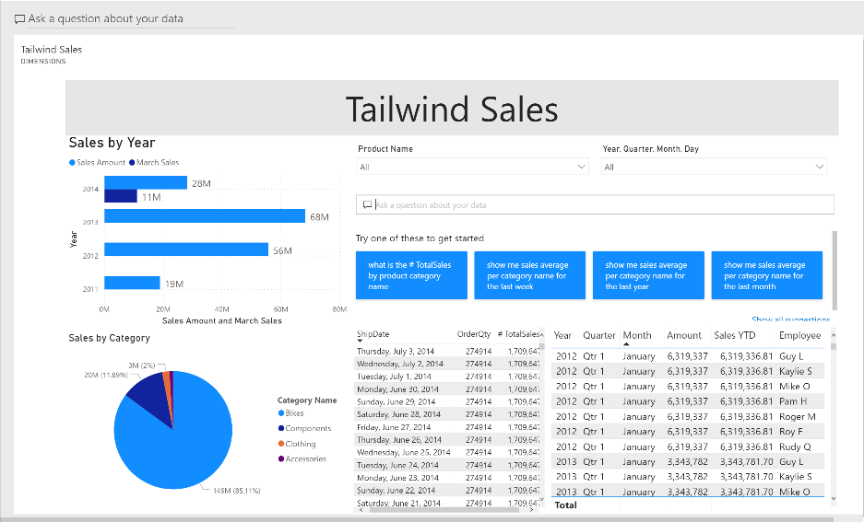
Pin a Live Report Page to a Dashboard
Ensure the visuals on your dashboard reflect changes live.
Notes:
The process of building reports and dashboards is iterative. As data is constantly refreshed and business requirements change, it is expected that your reports and dashboards might also change; both in what filters or slicers you might have and also in what report elements, charts, and cards you have. For this reason, it is crucial that Power BI supports this iterative process. Through Power BI's innate functionality to pin live report pages to a dashboard, you can ensure that you aren't using old data and the visuals on your dashboards reflect changes live.
Pin a live page
When you pin a visual, you can add it to a new or an existing dashboard. You can do the same with entire reports; when you pin a report page, all visuals on the report will be pinned to a dashboard and they are also live, meaning that any changes you make on the report will be immediately reflected on the dashboard that you have pinned the report to.
When you pin an entire page, the tiles are live; you can interact with them right there on the dashboard. And changes you make to any of the visualizations back in the report editor are reflected in the dashboard tile as well.
Any changes that you make to the tickets report will automatically show on the dashboard when the page is refreshed. In Power BI Desktop, you can make changes to your visuals or data as needed and then deploy to the appropriate workspace file, which will update the report and simultaneously update the dashboard as well.

Slide 11
Lesson 3: Enhance a dashboard

Slide 12
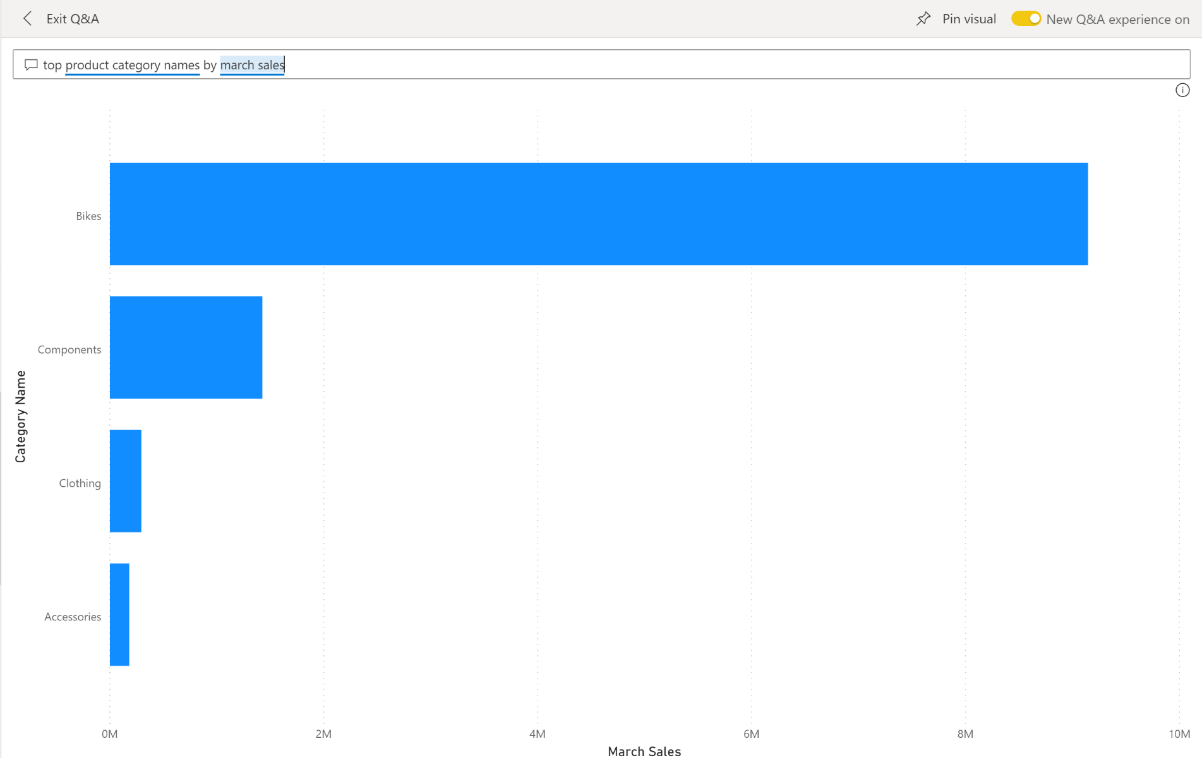
Explore Data by Asking Questions
Sometimes the fastest way to get an answer from your data is to ask a question using natural language.
Notes:
EXPLORE DATA IN YOUR OWN WORDS.
Power BI dashboards are about having a user-friendly experience. Dashboards in Power BI service are comprised of a canvas of interactive tiles, or report elements, that tell a data story. Sometimes the fastest way to get an answer from your data is to ask a question using natural language. The Q&A feature in Power BI lets you explore your data in your own words.
Q&A is interactive, even fun. Often, one question leads to others as the visualizations reveal interesting paths to pursue.
With Q&A, not only can you ask your data to speak for itself, you can tell Power BI how to display the answer. Just add "as a " to the end of your question. For example, "show inventory volume by plant as a map" and "show total inventory as a card". Try it for yourself.
When you're happy with the result, pin the visualization to a dashboard by selecting the pin icon in the top right corner.
Three main elements to the Q&A feature:
Question box: Enter their question about the data. An example of a question could be: What was the average sales amount by category? Entering this question will trigger Power BI's natural-language analysis engine to parse and determine the appropriate data to display.
Suggestion tiles: Contains tiles with pre-populated suggestions for questions that the user can consider asking. When the user selects one of these tiles, they will be shown analysis.
Pin visual: An icon that allows you to pin the visual into a new or existing dashboard.

Slide 13
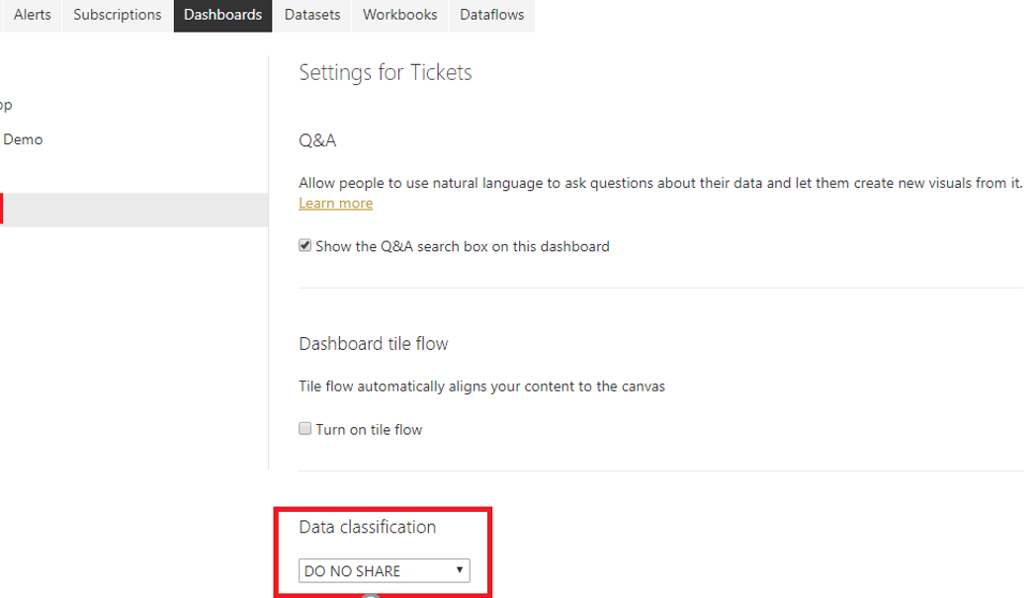
Configure Data Classification
Tag dashboards that alert users to the sensitivity of the data.
Notes:
Power BI dashboards are an effective and visually pleasing way to disseminate information. They allow you to share business insights and concisely tell you the story of the data. However, because they can be seen by anyone who has been given access or a link, an important concern is security.
Data classification helps the dashboard owner raise security awareness to viewers of a dashboard so that they know what level of security should be considered when viewing or sharing a dashboard. Data classification does not enforce policies because data protection does.
Data classification is a feature that can be turned on and off in accordance with your organization's business needs. All dashboards are defaulted to a certain classification type; however, the dashboard owner can manually make changes to the classification. To manually make changes, admin rights are required in Power BI service.
For instance, consider that you have built a few dashboards for the Sales team at your organization. You want to make sure that the users who have been given access know how the data within these dashboards is classified. Your organization has multiple ways to classify the data, and you want to incorporate and customize the data classification so that the dashboards have these custom classifications. Data classification in Power BI service allows you to complete this task.

Slide 14
Lab: Creating a Power BI Dashboard

Slide 15
Module Overview
We covered the following concepts:
Dashboards
Real-time Dashboards
Enhancing Dashboards
Notes:
In this module we discussed:
How to create and use Dashboards
How to create Real-time dashboards
How to enhance existing dashboards

